Slide 1
Do Nothing, Do Something, Aspirate: Management Of Early Pregnancy Loss
Sarah Prager, MD, MAS
Department of Obstetrics and Gynecology University of Washington

Slide 2
Disclosure Information and Conflicts of Interest
A conflict of interest occurs when an individual has an opportunity to affect educational content about health-care products or services of a commercial company with which she/he has a financial, professional, or personal relationship. The planners and presenters/authors of this CME/CNE activity have disclosed no relevant financial, professional, or personal relationship with any commercial interest organizations pertaining to this activity. Note: Please let us know on your evaluation form if you perceive commercial bias to be present in any educational session.

Slide 3
Objectives
By the end of this workshop participants will be able to:
Understand the diagnosis of early pregnancy loss
Describe relevance of EPL management in the ED/outpatient setting
Describe the uterine evacuation procedure using the manual uterine aspirator (MUA)

Slide 4
Nomenclature
Early Pregnancy Loss/Failure (EPL/EPF)
Spontaneous Abortion (SAb)
Miscarriage
These are all used interchangeably!
Manual Uterine Aspiration/Aspirator (MUA)
Manual Vacuum Aspiration/Aspirator (MVA)
Uterine Evacuation
Suction D&C/D&C/dilation and curettage

Slide 5
Background
Early Pregnancy Loss (EPL) is the most common complication of early pregnancy
10-20% clinically recognized pregnancies
~ 1,000,000 EPLs each year in the US
80% of EPLs occur in 1st trimester
Many women with EPL first contact medical care through the emergency room
Notes:
Studies show substantial percentage of pregnancies are lost prior to being clinically recognized.

Slide 6
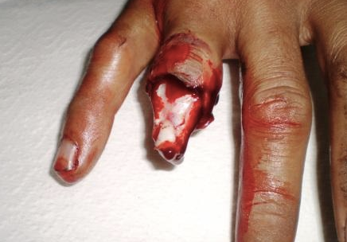
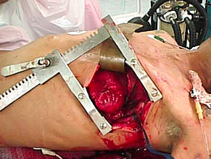
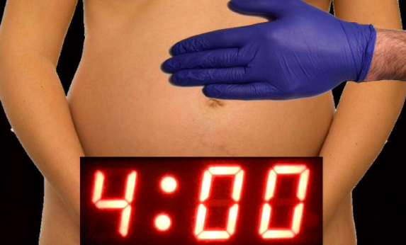
Notes:
As an emergency physician, I hope to bring my specialty’s perspective on the topic of miscarriage today. Or at least the perspective of some emergency physicians, we all practice with variable views of our role in miscarriage care, and what we consider to be an “emergency.”
Motivation for most of us to go into the field of emergency medicine comes from high stakes critical care cases: Dismemberment. Precariously placed weapons. Psychiatric instability. Resuscitative hysterotomies AKA perimortem C section. Traumas. Thoracotomies.

Slide 7
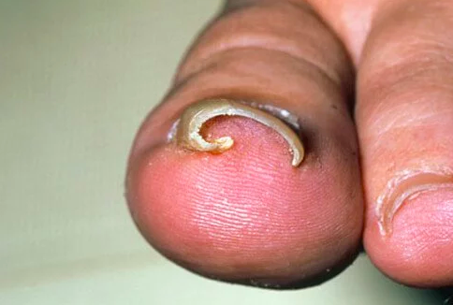
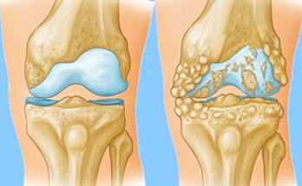
Notes:
In reality, a large portion of the patient care we provide is for patients with less acute conditions. That is STILL a crucial and large part of our jobs as emergency physicians, even if we consider our primary role to be that of a RESUSCITATIONIST.

Slide 8
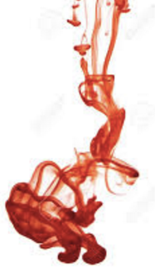
PREGNANT + BLEEDING
1.6% of chief complaints
500,000 annual ED visits
Notes:
as you know, up to 20% of recognized of pregnancies end in miscarriage, contributing to the 1.6% (500,000) of ED visits in the US annually (numbers from 1993-2003, probably higher now w/ increasing age of maternity)
As you know, cases of first trimester vaginal bleeding fall along the NONCRITICAL to CRITICAL spectrum
As EM physicians, our first charge is to evaluate for cases of ruptured and non-ruptured ECTOPIC pregnancy
For the patients with miscarriage, most will fall under the noncritical umbrella, with small amount of vag bleeding and HD stable, but we do see the rare cases of brisk hemorrhage causing hemodynamic instability and severe anemia requiring transfusions
You have undoubtedly already encountered EM physicians who believe that their principal and perhaps only goal as a care provider, and they call a consult quickly thereafter.
ACEP actually lists that as our main responsibility, so EM leadership not helping. And despite the EP’s role as a specialist in hemodynamic stabilization, scant emergency medicine literature addresses the management of patients with hemodynamically significant uterine bleeding in the ED
But you will find many EM physicians who want to provide better counseling and care, and want to help secure better f/u for our shared patients with first Tri miscarriage, and want to help implement MUAs at the bedside in the ED for pts not stable enough to be discharged.

Slide 9
Miscarriage is frustrating.
Notes:
Providing good care for first trimester miscarriage patients who present to the ED can be HARD. One thing to keep in mind is that cases of first trimester miscarriage treated in the ED can FRUSTRATING to everyone:
First and foremost - THE PATIENT (for those with equivocal testing, i.e. US with small material in uterus not meeting criteria for EPL - you have either 1. a normal early pregnancy, but you’re bleeding, 2. A miscarriage in progress, 3. A non-ruptured ectopic pregnancy, WE CAN’T be sure, and so just WAIT, GO HOME, and see your OBGYN provider for f/u and repeat blood testing and US.
Medical science can’t stop a miscarriage in progress
This is the latest in a series of miscarriages, emotions are high
Lack of privacy, poor counseling
THE EM PHYSICIAN - This isn’t an “EMERGENCY”, why don’t they just go to their OB.
Can they go to L&D?
Don’t know criteria for definitive dx of EPL, don’t have 24hr formal US, don’t have US skills (trained years ago)
Feel like they’re being asked to do more by many specialties
Is OBGYN team performing procedures and not updating us on our patients?
Lack knowledge of EPL treatment options, how to counsel patients
Delay to OBGYN consultants coming to ED, lack of consultant consideration of other patients/busy-ness of EDo
Erroneously think that all MUAs need conscious sedation
Bouncebacks for vaginal bleeding
The EM NURSE - MUA looks like an abortion
The OBGYN PHYSICIAN - We get called for so many cases of EPL without EM physicians … (performing pelvic, having US or Rh results
Come for consult, can’t find EM physician, nursing, a gynecological gurney, the patient!
EM physicians not understanding of L&D, surgery or other patient care load and cause for delay
Feels like work added to by EM consults

Slide 10
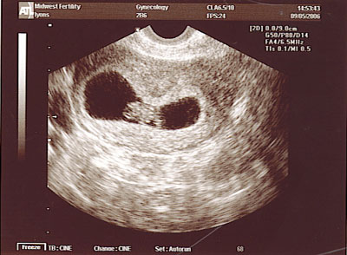
Samantha
26 yo G2P1 presents to the emergency room with vaginal bleeding after a positive home pregnancy test. An ultrasound shows a CRL of 7mm but no cardiac activity.
She wants to know why this happened.
Notes:
Case study to follow through the presentaion

Slide 11
Risk Factors for EPL
Age
Prior SAb
Smoking
Alcohol
Caffeine
Cocaine
Significant Chronic Stress
Maternal BMI <18.5 or >25
Low folate levels
Notes:
NSAIDs taken at time of conception
Fever in calendar month of conception
Folate low only in cases with aneuploid fetuses/embryos

Slide 12
Etiology
33% anembryonic
50% due to chromosomal abnormalities
Autosomal trisomies 52%
Monosomy X 19%
Polyploidies 22%
Other 7%
Host factors
Structural abnormalities
Maternal infection/endocrinopathy/coagulopathy
Unexplained

Slide 13
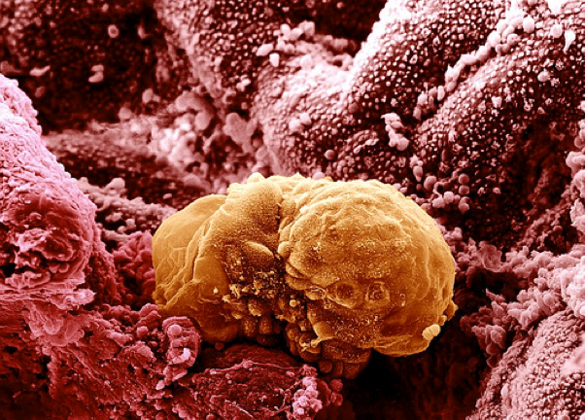
Normal Implantation and Development
Implantation:
5-7 days after fertilization
Takes ~72 hours
Invasion of trophoblast into decidua
Embryonic disc:
1 wk post-implantation
If no embryonic disc, trophoblast still grows, but no embryo (anembryonic pregnancy)
Embryonic disc embryonic/fetal pole

Slide 14
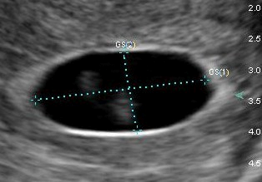
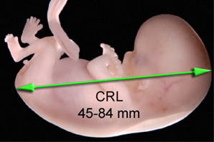
Ultrasound Dating in Normal Pregnancy
Mean Sac Diameter (mm) + 30
OR
Crown-Rump Length (mm) + 42
=
Gestational Age (days)

Slide 15
Clinical Presentation of EPL
Bleeding
Pain/cramping
Falling or abnormally rising ßhCG
Decreased symptoms of pregnancy
No symptoms at all!

Slide 16
Notes:
NEJM published the results of a meeting of radiologists and ultrasonographers for the US criterial for diagnosing EPL
TRANSVAGINAL studies
green highlighted areas are the most important for single US study to diagnose pregnancy failure with 100% specificity for a non-viable pregnancy with no false positives for IUFD, so a PPV of 100% for failed pregnancy (cutoff value for CRL and MSD where absence of cardiac activity reliably correlates with failed pregnancy)
other two criteria in L column require a second US (not normally applicable for EM practice)
R column: criteria SUGGESTIVE only, not diagnostic, for certain failed pregnancy
In reality, many EDs have access to 24hr US, or will consult their OBGYN departments to definitive Dx of EPL, but here it’s important to know that you have the ability to Dx EPL alone
Everything on the right are the criteria for uncertainty / lack of definitive dx

Slide 17
Samantha 26 yo G2P1, CRL of 7mm, no cardiac activity
Samantha and her partner request information on all the treatment options. You confirm the rest of her history.
Past Medical History: wisdom teeth removed
Ob History: term vaginal delivery without complication
Allergies: no known drug allergies

Slide 18
Management Options
Do Nothing: Expectant management
Do Something: Medical management
Aspirate: Uterine Aspiration
Sotiriadis A, Obstet Gynecol 2005 Nanda K, Cochrane Database Syst Rev 2006

Slide 19
Do Nothing Expectant Management
Requirements for therapy:
<13 weeks gestation
Stable vital signs
No evidence infection

Slide 20
Pain Management
Miscarriage is often painful
For patients wanting expectant or medical management, give pain medications for home use
NSAID
Ibuprofen 800 mg q 8
Naproxen 500 mg q 12
Narcotic of choice (Vicodin or Percocet, etc)
Treat pain in the ED as needed

Slide 21
Outcomes Expectant Management
Overall success rate 81%
Success rates vary by type of miscarriage (helpful to tailor counseling)
Incomplete/inevitable abortion 91%
Embryonic demise 76%
Anembryonic pregnancies 66%
Luise C, Ultrasound Obstet Gynecol 2002

Slide 22
What is Success? Definitions Used in Studies
≤15 mm endometrial thickness (ET) 3 days to 6 weeks after diagnosis
No vaginal bleeding
Negative urine hCG
Notes:
Many studies define failure as an endometrial thickness of 15 mm at some defined point in time

Slide 23
Problems with ET Cut-off
No clear rationale for this cut-off
Study of 80 women with successful medical abortion
Mean ET at 24 hours 17.5 mm (7.6–29 mm)
At one week 15% with ET >16 mm
Study of medical management after miscarriage
86% success rate if use absence of gestational sac
51% success rate if use ET ≤15 mm
Harwood B, Contraception 2001 Reynolds A, Eur. J Obstet Gynecol Reproduct. Biol 2005

Slide 24
When to Intervene for Expectant Management
Continued gestational sac
Clinical symptoms
Patient preference
Vaginal bleeding and positive UPT are possible for 2–4 weeks
Poor measures of success

Slide 25
Samantha 26 yo G2P1, CRL of 7mm but no cardiac activity
Samantha is continuing to bleed, though not heavily. She appears anxious about expectant management and shares with you that she really needs to do something before a follow up visit with her doctor.

Slide 26
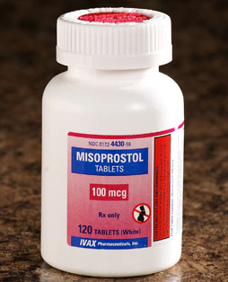
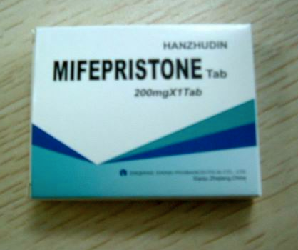
Do Something Medical Management
Misoprostol
Misoprostol + Mifepristone
Misoprostol + Methotrexate

Slide 27
Medical Management Requirement for Therapy
<13 weeks gestation
Stable vital signs
No evidence of infection
No allergies to medications used
Adequate counseling and patient acceptance of side effects

Slide 28
Misoprostol
Prostoglandin E1 analogue
FDA approved for prevention of gastric ulcers
Used off-label for many Ob/Gyn indications:
Labor induction
Cervical ripening
Medical abortion (with mifepristone)
Prevention/treatment of postpartum hemorrhage
Can be administered by oral, buccal, sublingual, vaginal and rectal routes
Chen B, Clin Obstet Gynecol 2007

Slide 29
Why Misoprostol?
Do something while still avoiding a procedure
Cost effective
Stable at room temperature
Readily available
Notes:
It’s a great option for women who want to do something, but avoid surgery

Slide 30
Misoprostol Dosing Medical Management
800 mcg per vagina or buccal
Repeat x 1 at 12–24 hours, if incomplete
Occasionally repeat more than once
Measure success as with expectant management
Intervene with Uterine Aspiration management as with expectant management
Success rate depends on type of miscarriage
100% with incomplete abortion
87% for all others
Wood SL, Obstet Gynecol 2002; Bagratee JS, Hum Reproduct 2004;
Blohm F, BJOG: Int J Obstet Gynecol 2005.

Slide 31
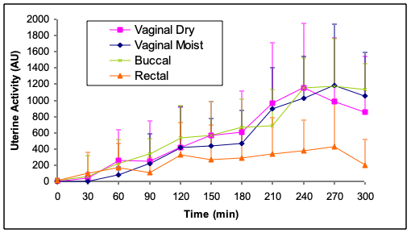
Uterine Activity Over 5 Hours Misoprostol by Route of Administration
Meckstroth, Obstetrics and Gynecology, 2006.

Slide 32
Side Effects and Complications Misoprostol vs. Placebo
Nausea/Vomiting: Increased with misoprostol (SL>oral>buccal>Rectal>vaginal)
Diarrhea: Increased with misoprostol (least with vaginal placement)
Pyrexia and shivering: increased with misoprostol (if persists past 8 hours, assess for infection)
Pain: More pain and analgesics needed in one study
Hemoglobin Concentration: No difference
Infection: No statistical difference placebo vs. misoprostol
90% women found medical management acceptable and would elect same treatment again
Wood SL, Obstet Gynecol 2002; Bagratee JS, Hum Reproduct 2004; Blohm F, BJOG: Int J Obstet Gynecol 2005

Slide 33
Notes:
Many of you are likely aware of the 2018 study published in the NEJM by Cori Schreiber out of UPENN that has changed the standard of care for medical management of first trimester miscarriage.
In various hospitals we’ve visited, the OBGYN departments are advocating for increased mifepristone availability in the ED to be able to use it for medical management of miscarriage. Some getting pushback, seen as abortion drug?

Slide 34
Mifepristone and Misoprostol Medical Management EPL
Mifepristone: Progestin antagonist that binds to progestin receptor
Used with elective medical abortion to “destabilize” implantation site
Current evidence-based regimen: 200 mg mifepristone + 800 mcg misoprostol
Success rates for mifepristone & misoprostol in EPL:
83.8% by day 2 (67.1% miso alone) RR 1.25[1.09 to 1.43]
87.8% by day 8 (71.1% miso alone) RR 1.23[1.10 to 1.39]
Need for uterine aspiration
8.8% by day 30 (23.5% miso alone) RR 0.37[0.21 to 0.68]
Mifepristone improves outcomes; use if you can easily
Gronlund A, Acta Obstet Gynaecol 1998; Nielsen S, Br J Obstet Gynaecol 1997;
Niinimaki M, Fertility Sterility 2006; Schreiber CA, Contraception 2006
Schreiber CA, Mifepristone Pretreatment for the Medical Management of EPL. NEJM June 2018
Notes:
Why not just add mife? Expensive, less available.

Slide 35
Methotrexate and Misoprostol Medical Management
Methotrexate
Folic acid antagonist
Cytotoxic to trophoblast
Used in medical management for ectopic pregnancy
Introduced in 1993 in combination with misoprostol to treat elective abortion medically
Success rates up to 98% (misoprostol administered 7 days after methotrexate)
No data for use in early pregnancy loss
Creinin MD, Contraception 1993

Slide 36
Samantha 26 yo G2P1, CRL of 7mm, no cardiac activity
Samantha opts to try misoprostol but returns to the ED 7 days later after checking a home pregnancy test and finding it still positive. She is worried the misoprostol didn’t work.
Samantha says that she had a period of heavy bleeding and is now spotting. Her cramping has resolved. She has noted a marked decrease in breast tenderness and nausea.
Her ultrasound shows a uniform endometrial stripe measuring 20mm in its greatest width.
Is she complete?

Slide 37
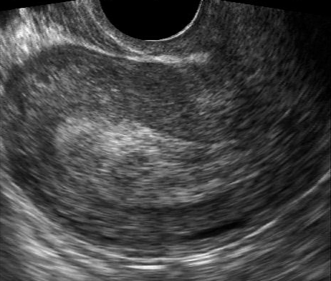
Samantha 26 yo G2P1, CRL of 7mm but no cardiac activity

Slide 38
Rebecca
32 yo G3P2 at 8 weeks by LMP was diagnosed with a fetal demise on her ultrasound and presents to the emergency room after 2 weeks of unsuccessful expectant management stating that she “needs to be done.” She declines medical management and requests an aspiration procedure right then, as it’s making her very anxious to carry a non-viable pregnancy.

Slide 39
Rebecca 32 yo G3P2, 8 weeks LMP, fetal demise, 2 weeks of expectant management, requesting uterine aspiration
Notify the OR and call OBGYN if needed?
Perform the uterine aspiration right then?
Is this an emergency?

Slide 40
Uterine Aspiration Management Early Pregnancy Loss
Who should have management with uterine aspiration?
Unstable
Significant medical morbidity
Infected
Very heavy bleeding
Anyone who WANTS immediate therapy

Slide 41
Uterine Aspiration Management Early Pregnancy Loss
BENEFITS
RISKS
Infection (1/200)
Perforation (1/2000)
Cervical trauma
Uterine synechiae (very rare)
Convenient timing
Observed therapy
High success rates (almost 100%)

Slide 42
Infection Prophylaxis Uterine Aspiration Management
Periabortal antibiotics ↓ infection risk 42%
No strong evidence on what to use
Doxycycline (1–14 doses)
100 mg bid x 7 days
200 mg x 1 preop
100 mg preop and 200 mg post op (ACOG recommendation)
Azithromycin 500 mg x 1
Test for gonorrhea and chlamydia per CDC guidelines
Prophylactic antibiotics v placebo for surgical management of EPL:
4.1% vs. 5.3% infection (p=0.09)
MUA: 1.3% v 4.1% risk ratio 0.32; (95% CI, 0.12 - 0.86)
Sharp Curettage: 5.3% v 6.0% risk ratio, 0.89 (95% CI, 0.64 - 1.23)
Sawaya GF, Obstet Gynecol 1996; Prieto JA, Obstet Gynecol 1995; Achilis SL, Reeves MF, SFP Clinical Guideline, Contraception, 2011; Lissauer, et al. NEJM, 2019
Notes:
No published data on need for ppx abx in EPL management.

Slide 43
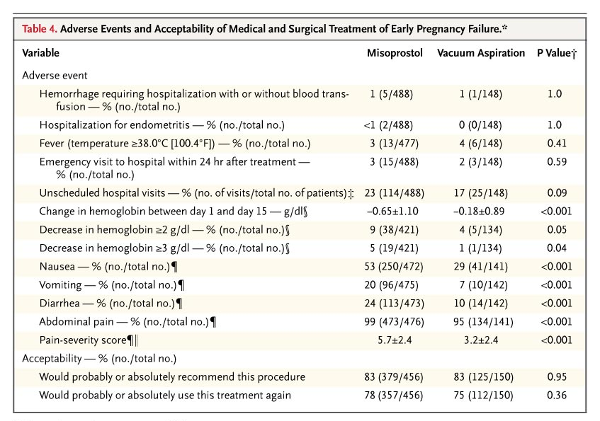
Zhang, NEJM 2005
Notes:
Patients randomly assigned to miso vs. D&C

Slide 44
Cost Analysis
A study estimating the economic consequences of expanding options for EPL treatment found that the cost per case was less for women in the expanded care model as compared with the usual care model.
Usual care
Expectant | $1274.58 per case
OR evacuation
Expanded care
Expectant | $1033.29 per case
Medication
Office evacuation
OR evacuation
Dalton VK, Liang A, Hutton DW, et al. Beyond usual care: the economic consequences of expanding treatment options in early pregnancy loss. Am J Obstet Gynecol 2015;212:177.e1-6.

Slide 45
Advantages of Keeping Treatment in the ED Setting
Reduction in Length of Stay
Average OR waiting time in UK-based study: 14 hr, with 42% of women not satisfied
Overall hospital stay: 19 hr (OR) to 6 hr (L&D ward or ED)
Time MUA to ED discharge: 99 min (n=9)
Demetroulis 2001; Lee and Slade 1996; Kinariwala 2013; Blumenthal 1994
Notes:
CORE SLIDE
NPO means nothing by mouth (fasting requirements).
Providing miscarriage management in the office has benefits for both the patient and the clinician.
Avoidance of repeated exams: When women present to the emergency room (ER) with signs and symptoms of a miscarriage, they may be put through many pelvic exams (first the ER resident, then the ER attending, often followed by the gyn resident and then the gyn attending—none of whom are usually the woman’s own physician). In a clinic setting, the woman usually undergoes one exam--by her own doctor, midwife, or nurse practitioner.
Long waits in the hospital: Women undergoing miscarriages are usually not acutely ill. Both in the emergency room as well as in the operating room, they usually receive care only after sicker patients have already been treated. Patients who received care in the hospital reported dissatisfaction with the fact that “miscarriage was not perceived by medical staff as important or an emergency” (Lee 1996). Women do not like these long waits.
Impersonal, mechanized environment in the operating room: The operating room environment is extremely high-tech and mechanized. Patients undergoing procedures in the operating room must adhere to strict protocols; this can be frustrating and intimidating for patients.
Source:
Lee C, Slade P. Miscarriage as a traumatic event: a review of the literature and new implications for intervention. J Psychosom Res 1996;40(3):235–244.

Slide 46
Advantages of Keeping Treatment in the ED Setting
Financial benefits
$125/MUA pack, $65/aspirator, $10/cannula
¯ Costs per case: $1,404 in OR vs $827 in L&D vs $200 or less in ER
MUA is reimbursable by Medicare
Avoid OR
Prolonged NPO requirements and discharge criteria
Risks of general anesthesia
OR overhead, staffing, costs and availability
Demetroulis 2001; Lee and Slade 1996; Kinariwala 2013; Blumenthal 1994
Notes:
CORE SLIDE
NPO means nothing by mouth (fasting requirements).
Providing miscarriage management in the office has benefits for both the patient and the clinician.
Avoidance of repeated exams: When women present to the emergency room (ER) with signs and symptoms of a miscarriage, they may be put through many pelvic exams (first the ER resident, then the ER attending, often followed by the gyn resident and then the gyn attending—none of whom are usually the woman’s own physician). In a clinic setting, the woman usually undergoes one exam--by her own doctor, midwife, or nurse practitioner.
Long waits in the hospital: Women undergoing miscarriages are usually not acutely ill. Both in the emergency room as well as in the operating room, they usually receive care only after sicker patients have already been treated. Patients who received care in the hospital reported dissatisfaction with the fact that “miscarriage was not perceived by medical staff as important or an emergency” (Lee 1996). Women do not like these long waits.
Impersonal, mechanized environment in the operating room: The operating room environment is extremely high-tech and mechanized. Patients undergoing procedures in the operating room must adhere to strict protocols; this can be frustrating and intimidating for patients.
Source:
Lee C, Slade P. Miscarriage as a traumatic event: a review of the literature and new implications for intervention. J Psychosom Res 1996;40(3):235–244.

Slide 47
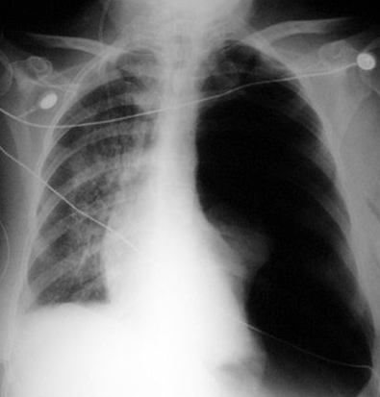
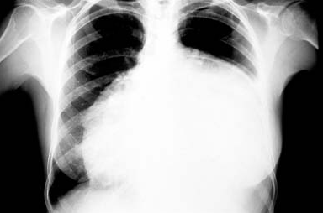
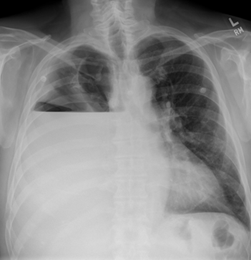
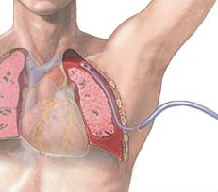
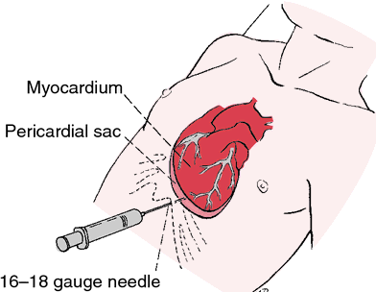
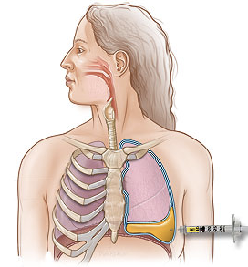
MUA complications: 0-0.11%
10%
2%
7%
Notes:
EM providers already perform procedures with higher complication rates (AND we perform conscious sedation also for shoulder /hip dislocations, fracture reductions,- MUA complications range from 0 - 0.11%; the most common complication is uterine perforation.
The only published study evaluating MUAs performed in an ED had a procedural complication rate of zero
Prevent hospital admissionsIn ED we commonly perform more technically difficult procedures with higher complication rates:
10%: Chest tube placement (3-10%, injuries of the lung, intercostal/intrathoracic vasculature, esophagus, stomach, liver, spleen, diaphragm, major blood vessels, and even cardiac structures
2%: Pericardiocentesis (1-2% complications, mortality, cardiac arrest, cardiac perforation leading to tamponade, pericardial/epicardial thrombus, cardiac chamber laceration requiring surgery, injury to an intercostal vessel, pneumothorax requiring chest tube placement, ventricular tachycardia, pulmonary edema and local/systemic infection
7%: Thoracentesis (3-7% risk PTX, < 1% HTX and REPE)

Slide 48
Use Outpatient/ED Management Cautiously in Women with…
Uterine anomalies
Coagulation problems
Active pelvic infection
Extreme anxiety
Any condition causing patient to be medically unstable
*In an urgent/emergent setting, use the MUA in the office/ED as soon as possible.
Notes:
CORE SLIDE
Before uterine aspiration, any life-threatening conditions should be addressed immediately.
Life-threatening conditions include: shock, hemorrhage, cervical or pelvic infection, sepsis, perforation, or abdominal injury as may occur with incomplete abortion or with clandestine abortion. Uterine aspiration with MVA is often an important component of definitive management in these cases, and once the patient is stabilized, the procedure should not be delayed.
Source:
Ipas Gynecological Aspiration System. MVA Label. U.S. English. 2004

Slide 49
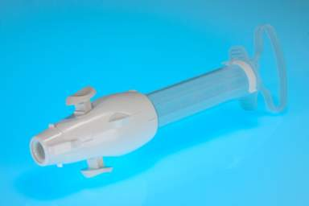
What is a Manual Uterine Aspirator?
Locking valve
Portable and reusable
Equivalent to electric pump
Efficacy same as electric vacuum (98%–99%)
Semi-flexible plastic cannula
Creinin MD, et al. Obstet Gynecol Surv. 2001.; Goldberg AB, et al. Obstet Gynecol. 2004. Hemlin J, et al. Acta Obstet Gynecol Scand. 2001.
Notes:
Talking Points
Using a 60-mL receptacle, the aspirator provides identical suction pressure (26 inches of mercury) to an electric pump until approximately 80% capacity. The aspirator can be quickly emptied and reused if more capacity is needed. It is portable and small. These qualities make it very practical for a variety of settings, including an office, emergency room, and hospital-based location.
NOTE TO SPEAKER: Hold up the instrument here and demonstrate vacuum on a finger or palm of hand. Explain that vacuum is produced by locking the valves, which seals off one end of the aspirator, and then withdrawing the plunger.
References
Creinin MD, Schwartz JL, Guido RS, Pymar HC. Early pregnancy failure—current management concepts. Obstet Gynecol Surv. 2001;56(2):105–13.
Goldberg AB, Dean G, Kang MS, Youssof S, Darney P. Manual versus electric vacuum aspiration for early first-trimester abortion: a controlled study of complication rates. Obstet Gynecol. 2004;103:101–7.
Hemlin J, Moller B. Manual vacuum aspiration, a safe and effective alternative in early pregnancy termination. Acta Obstet Gynecol Scand. 2001;80:563–67.
- - -
Original content for this slide submitted by the ARHP Clinical Advisory Committee for the Manual Vacuum Aspiration Education Partnership Project in December 2004. Original funding received from Ipas and the John Merck Fund through an unrestricted educational grant. Last reviewed/updated by the ARHP Clinical Advisory Committee for the Manual Vacuum Aspiration Education Partnership Project in October 2007. This slide is available at www.arhp.org/core.

Slide 50
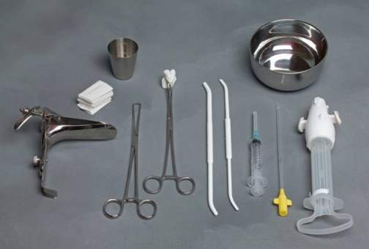
MUA Instruments
Notes:
Talking Points
This slide shows supplies needed to perform MVA procedures.
The aspirator shown on the right is a double-valve syringe.
Refer to directions for use with each manufacturer’s product.
- - -
Original content for this slide submitted by the ARHP Clinical Advisory Committee for the Manual Vacuum Aspiration Education Partnership Project in December 2004. Original funding received from Ipas and the John Merck Fund through an unrestricted educational grant. Last reviewed/updated by the ARHP Clinical Advisory Committee for the Manual Vacuum Aspiration Education Partnership Project in October 2007. This slide is available at www.arhp.org/core.

Slide 51
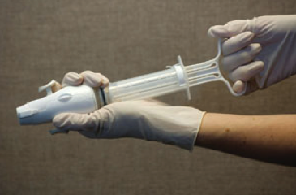
Complications with MUA
Very rare
Same as EUA
May include:
Incomplete evacuation
Uterine or cervical injury
Infection
Hemorrhage
Vagal reaction
MVA Label. Ipas. 2004.
Notes:
Talking Points
Complications of MVA are the same as those that may result from EVA.
FDA warnings on Ipas’s MVA label are:
Incomplete evacuation
Uterine or cervical injury or perforation
Pelvic infection
Acute hematometra
Vagal reaction
In an interactive setting, the trainer may wish to incorporate some of the cases listed on the Word document entitled “MVA Cases for Discussion” with the accompanying key. Complications are covered in cases 5, 7, and 8. The other cases listed pertain to general clinical issues of MVA.
Reference
MVA Label, United States, English. Ipas. 2004.
- - -
Original content for this slide submitted by the ARHP Clinical Advisory Committee for the Manual Vacuum Aspiration Education Partnership Project in December 2004. Original funding received from Ipas and the John Merck Fund through an unrestricted educational grant. Last reviewed/updated by the ARHP Clinical Advisory Committee for the Manual Vacuum Aspiration Education Partnership Project in October 2007. This slide is available at www.arhp.org/core.

Slide 52
Rebecca 32 yo G3P2, 8 weeks LMP, fetal demise, 2 weeks of expectant management, requesting uterine aspiration
Rebecca is wanting to have her procedure right there in the ED, but she is concerned about the pain.
Would it be different if she had presented directly to the emergency department for care?
What can you tell her about pain management in an outpatient clinic?

Slide 53
Pain Management Techniques
General or nitrous
10%
With addition of:
Respectful, informed, and supportive staff
Focused breathing: 76%
Visualization: 31%
Localized massage: 14%
32%
58%
Local + IV
(fentanyl +/- midazolam)
Local (paracervical block with lidocaine)
Lichtengerg ES, et al. Contraception. 2001.
Good M, et al. Pain Manag Nurs. 2002.
Notes:
Talking Points
This slide shows pain control techniques used by National Abortion Federation (NAF) clinics (Lichtenberg et al. 2001). This is a particularly helpful slide in locations where the group feels that “their patients will only tolerate general anesthesia.” In general, NAF clinics provide high-quality abortion care and strive to make sure that their customers are satisfied. Pain management matters a lot to women. The fact that the majority of NAF clinics offer local anesthesia as a primary method of pain control strongly implies that many women use this option.
This slide can also be used to make the point that ancillary methods of pain management, such as focused breathing, visualization, and massage, are important.
Music may also be helpful in reducing pain perception. A study of the effect of music and relaxation after gynecological surgery found that both interventions significantly reduced the reported level of pain (Good et al. 2002).
References
Lichtenberg ES, Paul M, Jones H. First trimester surgical abortion practices: a survey of National Abortion Federation members. Contraception. 2001;64:345–52.
Good M, Anderson GC, Stanton-Hicks M, Grass JA, Makii M. Relaxation and music reduce pain after gynecologic surgery. Pain Manag Nurs. 2002;3:61–70.
- - -
Original content for this slide submitted by the ARHP Clinical Advisory Committee for the Manual Vacuum Aspiration Education Partnership Project in December 2004. Original funding received from Ipas and the John Merck Fund through an unrestricted educational grant. Last reviewed/updated by the ARHP Clinical Advisory Committee for the Manual Vacuum Aspiration Education Partnership Project in October 2007. This slide is available at www.arhp.org/core.

Slide 54
Oral Pain Medications for Uterine Aspiration
NSAID
Ibuprofen 800 mg
Naproxen 500 mg
Benzodiazepine
Ativan 1-4 mg
Valium 2-10 mg
Narcotic
Not routinely recommended
Doesn’t increase pain control
Increases vomiting
Micks E, et al. Hydrocodone-acetaminophen for pain control in first trimester surgical abortion:
a randomized controlled trial. Obstet Gynecol. 2012 Nov; 120(5): 1060-9.

Slide 55
Efficacy of Ancillary Anesthesia
Importance of psychological preparation and support
Music as analgesia for abortion patients receiving paracervical block
85% who wore headphones rated pain as “0,”
compared with 52% of controls
Verbicaine (“Vocal Local”)/Distraction Therapy
Shapiro AG, Cohen H. Contraception. 1975.
Stubblefield PG.Suppl Int J Gynecol Obstet. 1989.
Notes:
Talking Points
Residency programs in the United States often do not emphasize ancillary techniques of pain management for procedures on awake patients. Dentists have known for a long time that if patients hear music through headphones and are otherwise treated nicely while they have their teeth drilled, the patients feel less pain.
In a study from the University of Miami in 1974, 144 women undergoing first-trimester abortion with suction curettage, oral valium, and paracervical block were randomly assigned to 1) standard technique, 2) headphones with music, or 3) self-administered methoxyflurane. The group using the headphones had less than half the incidence of pain of the other two groups: 85% of the group with headphones said they had no pain, compared with 52% of the other two groups.
Pre-procedure fearfulness appears to play a major role in the amount of pain women perceive. Stubblefield noted that women who know what to expect through better education and psychological preparation tend to be less afraid, which may be associated with reduced pain.
References
Shapiro AG, Cohen H. Auxiliary pain relief during suction curettage. Contraception. 1975;11(1):25–30.
Stubblefield PG. Control of pain for women undergoing abortion. Suppl Int J Gynecol Obstet. 1989;3:131–40.
- - -
Original content for this slide submitted by the ARHP Clinical Advisory Committee for the Manual Vacuum Aspiration Education Partnership Project in December 2004. Original funding received from Ipas and the John Merck Fund through an unrestricted educational grant. Last reviewed/updated by the ARHP Clinical Advisory Committee for the Manual Vacuum Aspiration Education Partnership Project in October 2007. This slide is available at www.arhp.org/core.

Slide 56
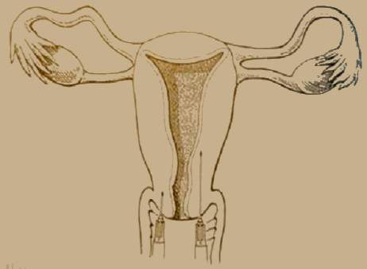
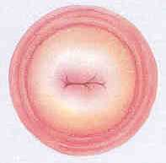
Paracervical Block
Deep Injection
Regular Injection
1% Lidocaine 20 cc block
1cc at 12:00
10 cc at 4:00 and 8:00
½ deep and ½ tracking back through the cervix.
Castleman L, Mann C. 2002. Maltzer DS, et al. 1999.
Notes:
Talking Points
Paracervical block is commonly used for vacuum aspiration abortions in North America. However, clinicians use many different techniques for administering a paracervical block. “There is a little science and a lot of art in this area” (Maltzer et al. 1999, p. 77). Studies have shown that deep injections using the Glick technique can be more effective than superficial injections and that injecting slowly has been found to be less painful than injecting quickly.
The trainer may want to be prepared to discuss techniques for administering a paracervical block, because this is a very commonly asked question. Approaches and evidence are discussed fully in the sources listed below.
References
Castleman L, Mann C. Manual Vacuum Aspiration (MVA) for Uterine Evacuation: Pain Management. Chapel Hill, NC: Ipas, 2002.
Maltzer DS, Maltzer MC, Wiebe ER, Halvorson-Boyd G, Boyd C. Pain management. In: NAF’s A Clinician’s Guide to Medical and Surgical Abortion. Philadelphia: Churchill Livingstone, 1999.
- - -
Original content for this slide submitted by the ARHP Clinical Advisory Committee for the Manual Vacuum Aspiration Education Partnership Project in December 2004. Original funding received from Ipas and the John Merck Fund through an unrestricted educational grant. Last reviewed/updated by the ARHP Clinical Advisory Committee for the Manual Vacuum Aspiration Education Partnership Project in October 2007. This slide is available at www.arhp.org/core.

Slide 57
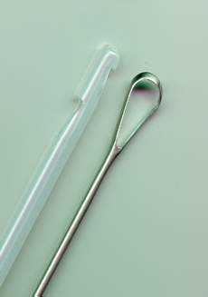
Sharp Curettage and Pain
Requires increased dilatation
Increases pain
Not recommended for routine use after MUA
Forna F, Gulmezoglu AM. Cochrane Library. 2002.
WHO. 2003
Notes:
Talking Points
Studies on incomplete abortion reveal that suction causes less pain than sharp curettage.
Reference
Forna F, Gulmezoglu AM. Surgical procedures to evacuate incomplete abortion (Cochrane Review). In: The Cochrane Library 2002; Issue 1. Oxford: Update Software.
- - -
Original content for this slide submitted by the ARHP Clinical Advisory Committee for the Manual Vacuum Aspiration Education Partnership Project in December 2004. Original funding received from Ipas and the John Merck Fund through an unrestricted educational grant. Last reviewed/updated by the ARHP Clinical Advisory Committee for the Manual Vacuum Aspiration Education Partnership Project in October 2007. This slide is available at www.arhp.org/core.

Slide 58
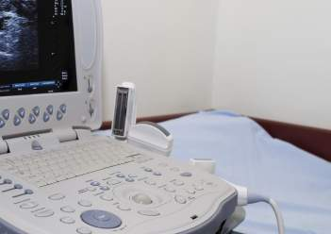
Ultrasound and MUA
Not required for MUA
Used by some providers routinely
Use contingent on provider preference and experience
You can use to help diagnose non-viable pregnancy prior to EPL management
Word Health Organization. 2003.
Notes:
Talking Points
MVA is simple and portable and can be easily integrated into an office practice.
Although many training centers routinely use ultrasound, lack of ultrasound should not prevent clinicians from offering MVA to women.
MVA is practiced safely and effectively in many settings that do not have ultrasound.
Reference
WHO. Safe Abortion: Technical and Policy Guidance for Health Systems. Geneva, Switzerland: World Health Organization, 2003
- - -
Original content for this slide submitted by the ARHP Clinical Advisory Committee for the Manual Vacuum Aspiration Education Partnership Project in December 2004. Original funding received from Ipas and the John Merck Fund through an unrestricted educational grant. Last reviewed/updated by the ARHP Clinical Advisory Committee for the Manual Vacuum Aspiration Education Partnership Project in October 2007. This slide is available at www.arhp.org/core.

Slide 59
Rebecca 32 yo G3P2, 8 weeks LMP, fetal demise, 2 weeks of expectant management, requesting uterine aspiration
Rebecca has her uterine aspiration with MUA procedure right then in the clinic.
The procedure is uncomplicated and her questions after include:
“Can I get pregnant right away?”
“Am I at risk for another miscarriage?”

Slide 60
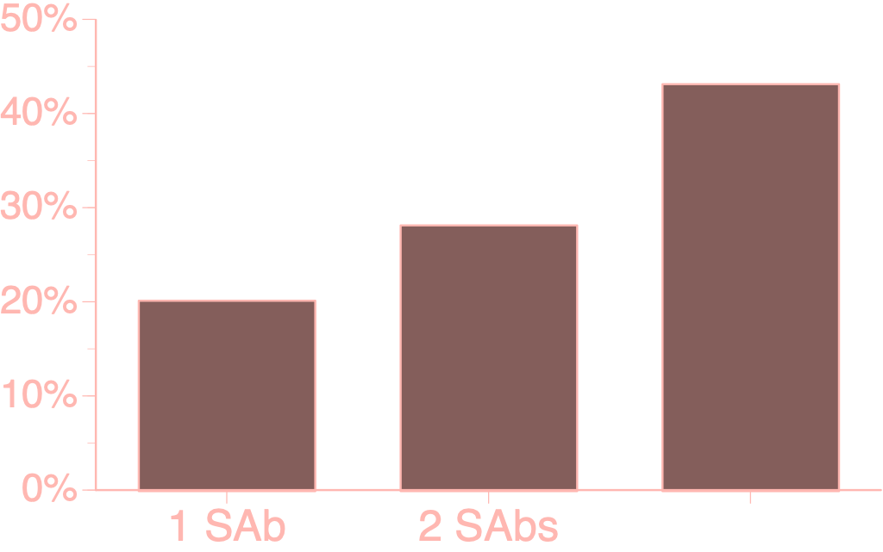
Future Miscarriage Risk
43%
28%
20%
Regan L, et al. Influence of past reproductive performance on risk of spontaneous
abortion. BMJ. 1989

Slide 61
Post Early Pregnancy Loss Care
Rhogam at time of diagnosis or surgery
No evidence for delaying conception
Initiate contraception upon completion of procedure (even IUDs!)
Expect light-moderate bleeding for 2 weeks
Menses return after 6 weeks
Negative ßhCG values after 2–4 weeks
Appropriate grief counseling
Goldstein R, Am J Obstet. Gynecol 2002; Wyss P, J Perinat Med 1994; Grimes D, Cochrane Database Syst Rev 2000

Slide 62
When Women Should Contact Clinician
Heavy bleeding with dizziness, lightheadedness
Worsening pain not relieved with medication
Flu-like symptoms lasting >24 hours
Fever or chills
Syncope
Any questions
Notes:
Talking Points
As part of instructions for aftercare, women should be told when to contact the clinician after an abortion procedure. These indications include:
Bleeding that is becoming heavier and causing any dizziness or lightheadedness. Usually vaginal bleeding gets lighter over time.
Heavy bleeding is soaking two or more maxi-pads per hour for more than 2 hours.
Pain that is worsening, especially if it is not improved with ibuprofen.
Fever or chills.
Flu-like symptoms that last more than 24 hours.
Syncope.
Any questions.
- - -
Original content for this slide submitted by the ARHP Clinical Advisory Committee for the Manual Vacuum Aspiration Education Partnership Project in December 2004. Original funding received from Ipas and the John Merck Fund through an unrestricted educational grant. Last reviewed/updated by the ARHP Clinical Advisory Committee for the Manual Vacuum Aspiration Education Partnership Project in October 2007. This slide is available at www.arhp.org/core.

